Slide 1
This Power Point presentation belongs to the Danish Renal Registry, which owns the copyright. It can be freely used for non-commercial study and educational purposes. Any commercial use or publication requires the prior permission of the Danish Renal Registry.

Slide 2
Dialysis Modality Survival: Temporal Changes
Heaf JG¹, Wehberg S²
¹Herlev Hospital, University of Copenhagen
²Research Unit of Clinical Epidemiology, Centre for National Clinical Databases – South, University of Southern Denmark and Odense University Hospital, Odense, Denmark

Slide 3
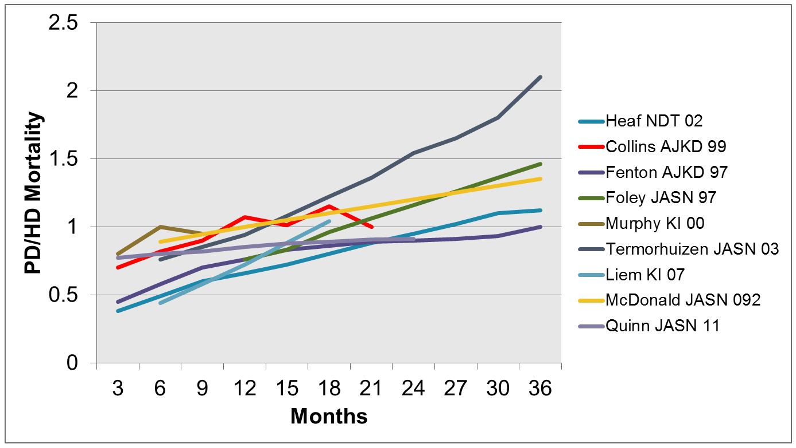
HD vs. PD: Status 2011

Slide 4
Introduction
Many epidemiological studies comparing PD & HD mortality.
Most show a survival advantage for PD during the first 1-2 years of ESRD.
Long-term results show either equivalent results or a worse prognosis for PD.
The practice of dialysis has changed considerably during the last 20 years. We studied changes in relative and absolute mortality over the past 20 years

Slide 5
Patients
All 12,095 patients (63% male, 23% diabetic) treated with dialysis were included from the Danish Nephrology Registry database between 1.1.1990 and 31.12.2010.
The registry is national, comprehensive and prospective.
The Charlson comorbidity index (CCI) derived from recorded discharge diagnoses in the National Admissions Registry during the 10 years prior to ESRD.
Major diagnoses:
shrunken kidneys 23%
glomerulonephritis 12%
chronic interstitial 11%
polycystic 7%
hypertensive 12
Type 1 DM 12%
Type 2 DM 11%,

Slide 6
Methods
Patients followed from first dialysis day to either death, lost-to-follow-up, transplantation, i.e. an intention-to-treat (ITT) analysis.
The effect of diagnosis, CCI, comorbidity components and cohort were investigated.
PD and HD modalities compared using Cox proportional hazards analysis, correcting for age, sex, renal diagnosis and CCI.

Slide 7
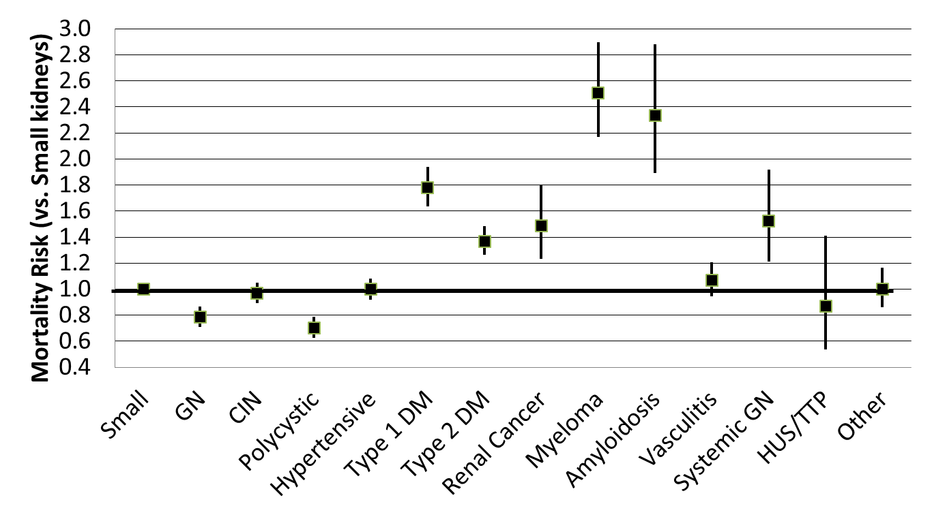
Influence of Renal Diagnosis
1990-2010
Dialysis patients only
Censored for transplant.
Age- and sex-adjusted.
95% confidence interval

Slide 8
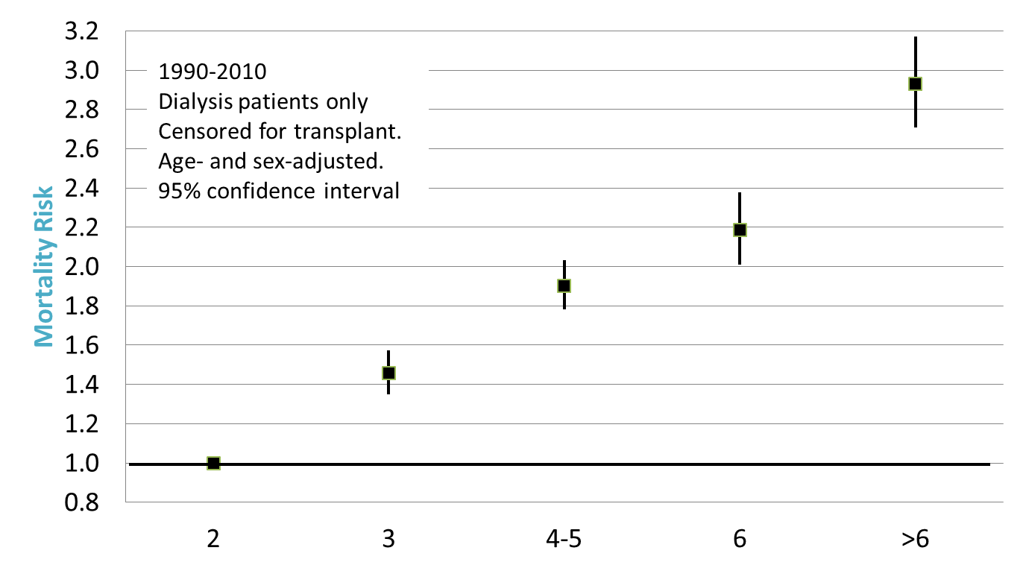
Influence of Charlson Comorbidity Score
Charlson Score

Slide 9
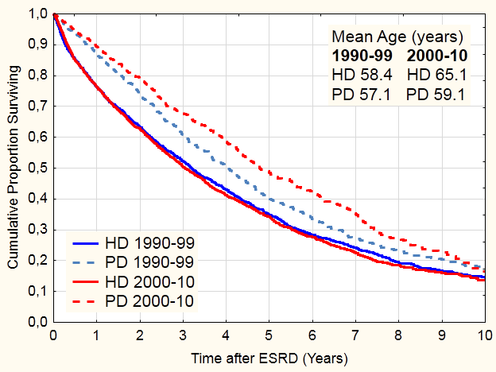
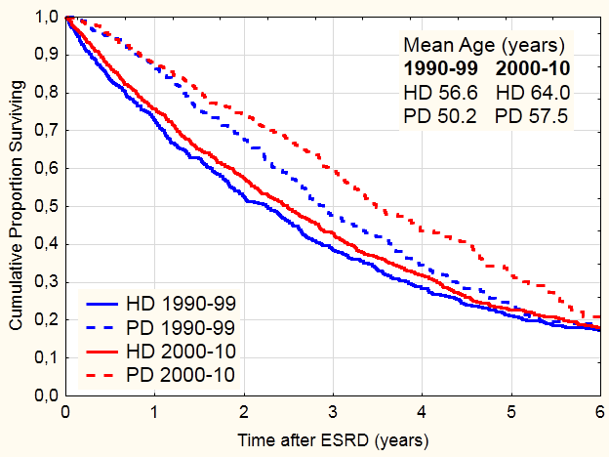
Unadjusted Patient Survival (ITT)
Non-DM
DM

Slide 10
Increasing Comorbidity 1990-2011

Slide 11
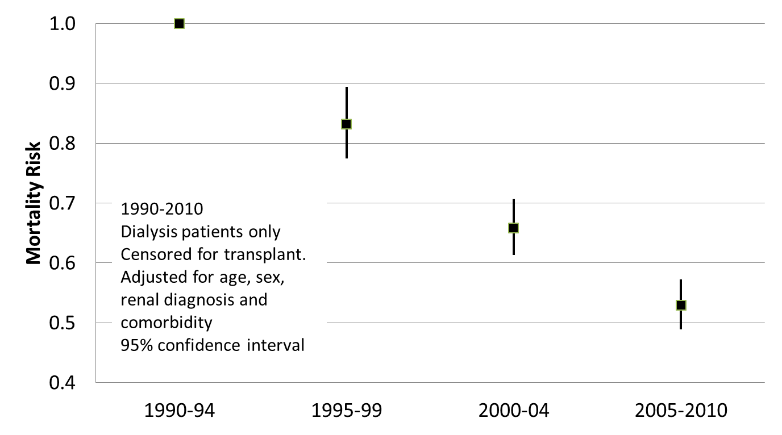
Influence of Cohort
Charlson Score

Slide 12
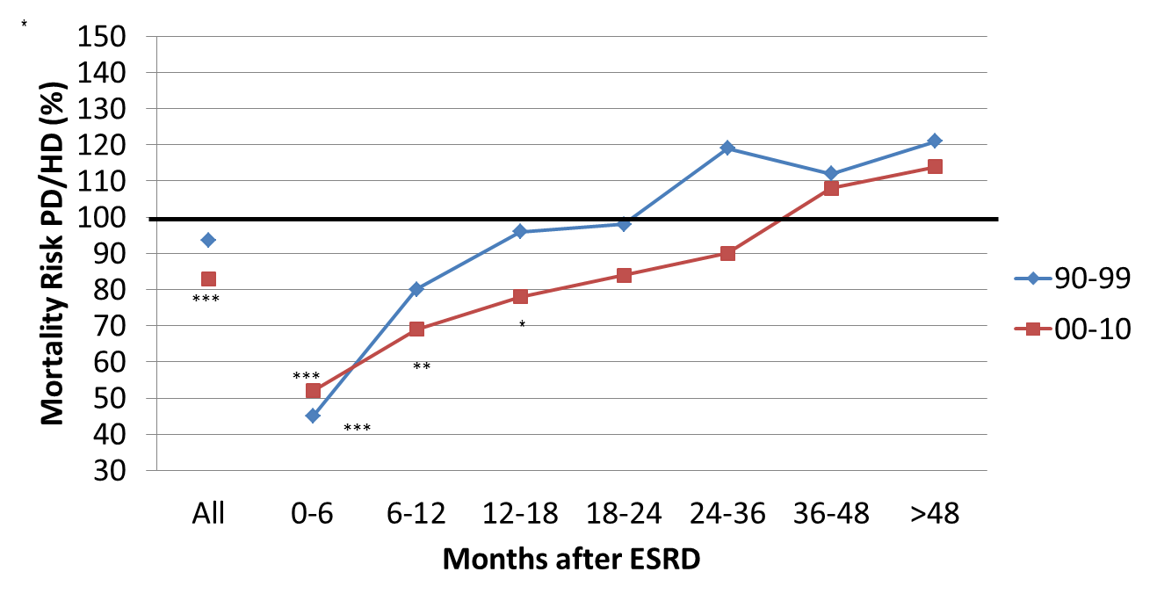
Dialysis Modality & Cohort
Significant difference from 100%: ***:p<0.001; **:p<0.01; *:p<0.05

Slide 13
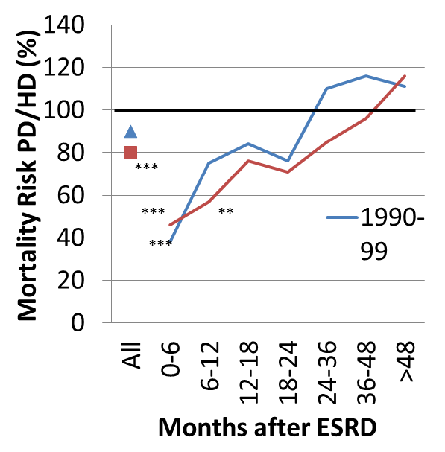
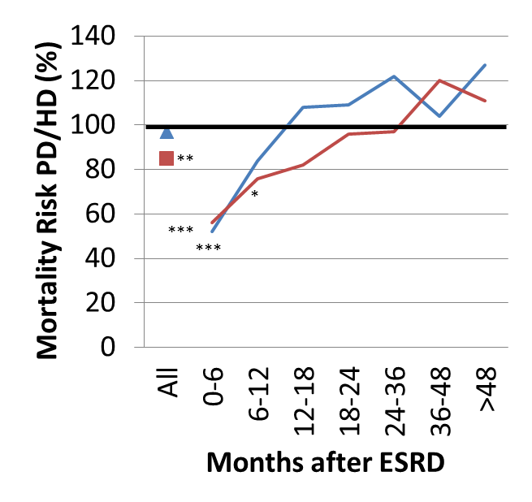
Dialysis Modality and Age
<65 years
>65 years
***:p<0.001; **:p<0.01; *:p<0.05

Slide 14
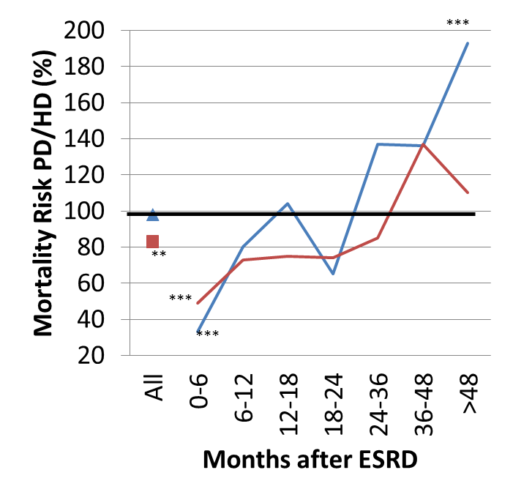
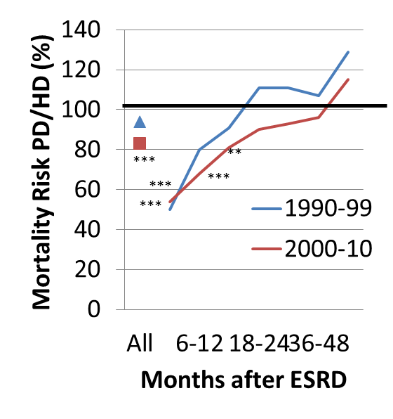
Dialysis Modality & Diabetes
Non-DM
DM
Significant difference from 100%: ***:p<0.001; **:p<0.01; *:p<0.05

Slide 15
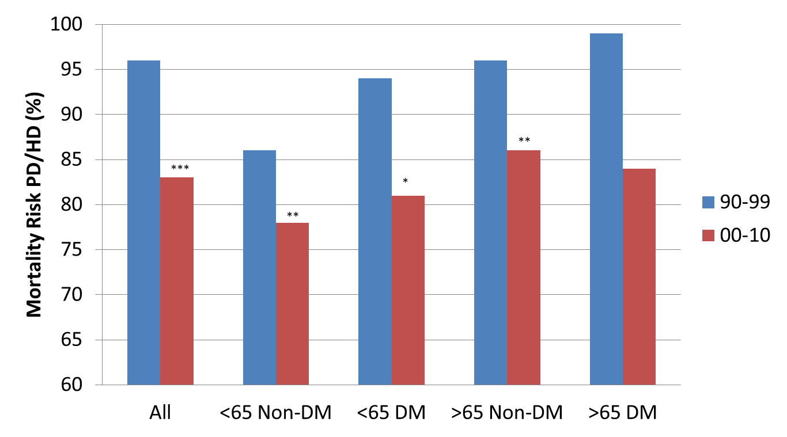
Dialysis Modality: Summary
Significant difference from 100%: ***:p<0.001; **:p<0.01; *:p<0.05

Slide 16
Results
A fall in dialysis mortality was seen (HD -46%, PD -51%)
An initial survival advantage for PD lasting up to 2 years of ESRD was found and was common for all subgroups. PD outcomes after 4 years were poorer than HD.
Overall, PD prognosis was better than HD, and an improvement during the 21 years was seen (relative risk 94% in 1990-94 falling to 81% in 2005-10, p<0.001).

Slide 17
Possible Common Causes of Improved Prognosis
Defined Kt/V targets
Better Ca/P/PTH control
Improved predialysis planning (eGFR)
Earlier dialysis start (factitious cause)
Elderly dialysis patients do relatively better (falling mortality risk from 1.64 to 1.51/decade).
This is also possibly a factitious cause, since more elderly patients were included in later cohorts
Reduced tobacco consumption
Better cardiological treatment
? EPO/hypertension/ACE-I/diet ?
No evidence of therapeutic changes during study period

Slide 18
Possible specific causes of improved prognosis
HD
PD
Biocompatible membranes
Lower intradialytic morbidity
”Floating” dry weight Rx
(No change in fistula use)
Lower peritonitis frequency
Better fluid control
High transport problem solved
APD
Icodextrin
Less glucose Rx
Improved catheter technology/placement

Slide 19
Conclusions
The adjusted mortality of dialysis patients has improved substatially since 1990.
The relative survival advantage of PD versus HD has improved since 2000.
No subgroup was identified where PD had a survival disadvantage compared to HD.
As in all epidemiological studies, caution is required in interpretation, due to the possible presence of unidentified confounders.

